Slide 1
CAPSTONE PRESENTATION
Daniel Fernandez (490105980) with Joseph Lizier:
Applying the KSG Estimator to Mixed Continuous-Discrete Data in JIDT

Slide 2
Goals and Scope (1)
The KSG estimator is best-in-class for estimating mutual information between two (or more) variables.
It uses a k-nearest-neighbours approach with k as a hyperparameter.
Implementations already exist and tested for cases where all variables are either discrete or continuous.
JIDT recently added capability for mixed data types. In the most basic case, X is a discrete variable and Y is a continuous variable.
The overarching theme of this project is to validate that implementation in JIDT and perform analysis of any questions that throws up.

Slide 3
Goals and Scope (2)
Breaking that down a little further…
The initial goal will be to replicate plots by Ross (2015) in which X took 3 different values and he varied the value of k.
The second goal will be to explore the dependence of the reliability of the estimator upon the sample size N.
The third goal (not in slides, may demo) is to test a second, related, estimator for conditional mutual information.
In all cases, we will be using synthetic data from a known distribution. This means that the estimators will still work empirically (surprise) but we are able to compare their results with a true value, computed by numerical evaluation of sums and integrals.

Slide 4
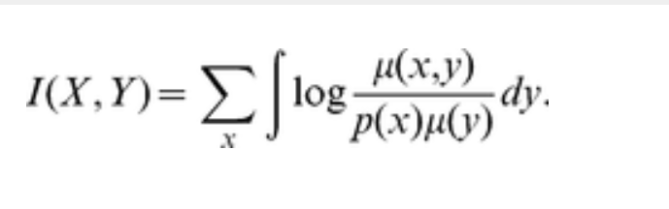
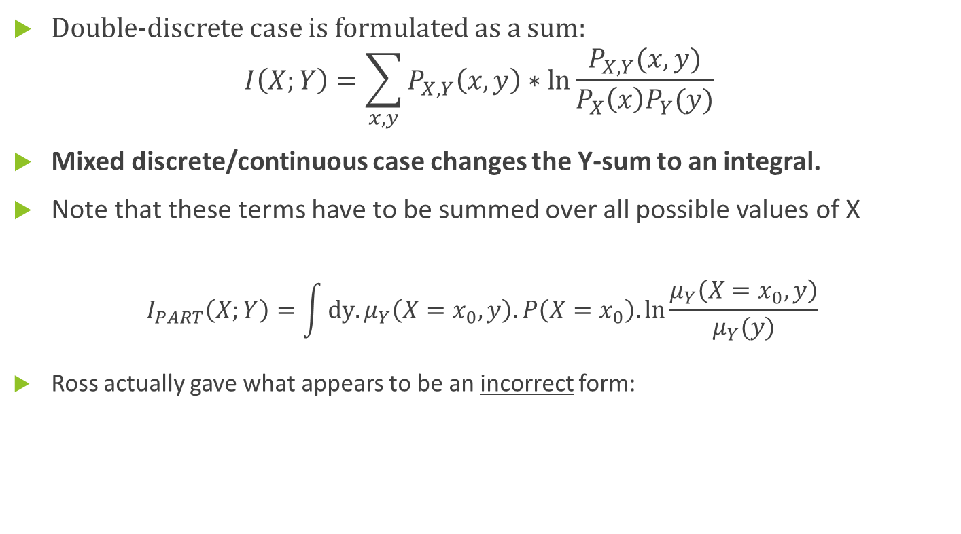
Background to Mutual Information (1)
Double-discrete case is formulated as a sum:
$$I\left(X;Y\right)=\sum_{x,y}{P_{X,Y}\left(x,y\right)∗ln⁡\frac{P_{X,Y}(x,y)}{P_{X}\left(x\right)P_{Y}(y)}}$$
Mixed discrete/continuous case changes the Y-sum to an integral.
Note that these terms have to be summed over all possible values of X
$$I_{PART}\left(X;Y\right)=\int{dy.μ_{Y}\left(X=x_{0},y\right). P\left(X=x_{0}\right). ln⁡\frac{μ_{Y}\left(X=x_{0},y\right)}{μ_{Y}(y)}}$$
Ross actually gave what appears to be an incorrect form:

Slide 5
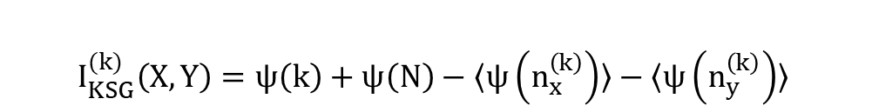
Background to Mutual Information (2)
The KSG algorithm as described in my report:
For each point in a dataset of N points:
Define the smallest rectangle centred upon it such that its k nearest neighbours are contained within
Extend the rectangle in the y-direction and count the number of points that fall within this extended rectangle to obtain n_{y}
Extend the rectangle instead in the x-direction and do likewise to obtain n_{x}
Take digamma functions of all results from steps II and III, then average over all N points.
Combine the results in the following fashion:
$$I_{KSG}^{(k)}\left(X,Y\right)=ψ\left(k\right)+ψ\left(N\right)−〈ψ\left(n_{x}^{\left(k\right)}\right)〉−〈ψ\left(n_{y}^{\left(k\right)}\right)〉$$

Slide 6
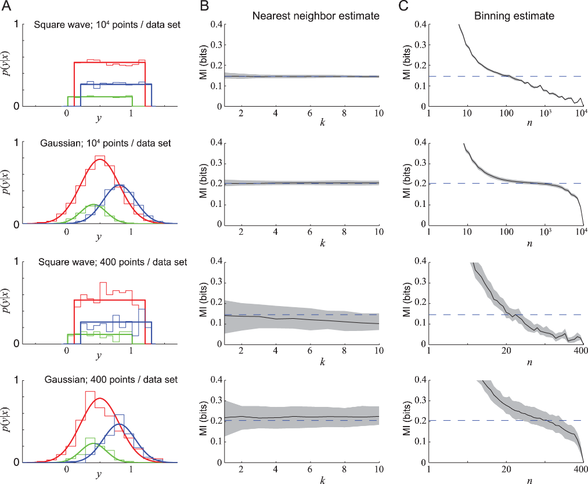
Ross results
Replicating Column B (with minor concessions to information-theoretic orthodoxy) will be our first goal.

Slide 7
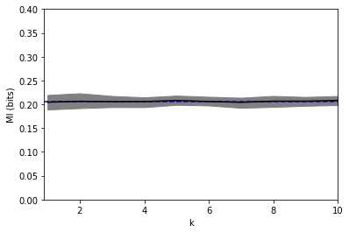
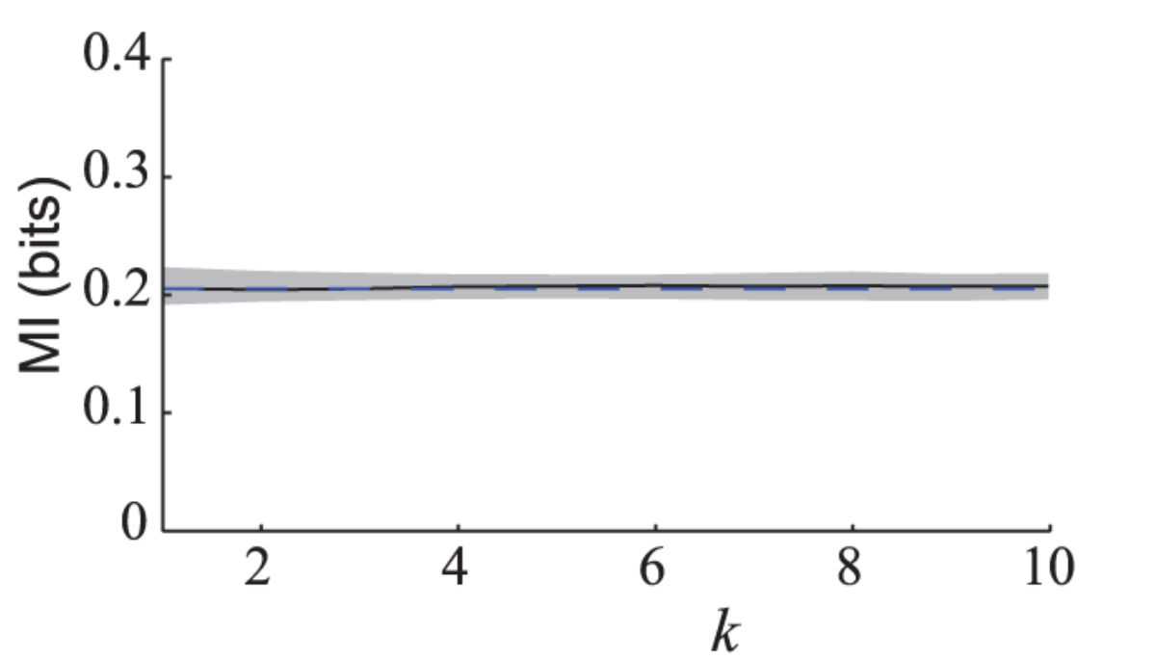
Full replication 1 (Gaussian, N=10000)
1. Own plot is on the left. Ross’ is on the right.
2. The blue dotted line represents the true value of the distribution’s MI (around 0.205 bits.)
3. The shaded area covers the 10th to 90th percentile (!)

Slide 8
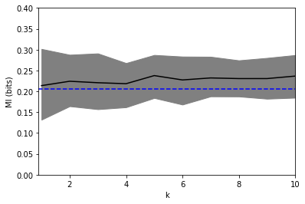
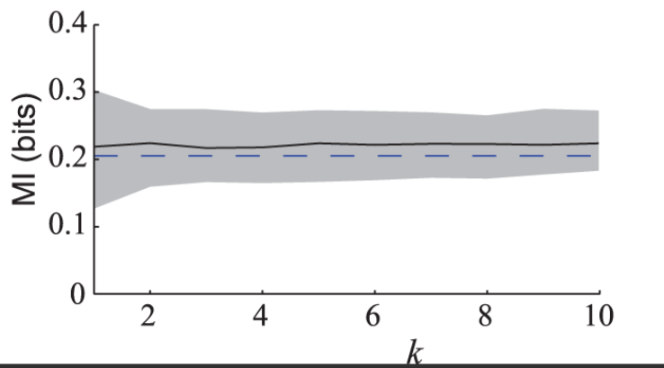
Full replication 2(Gaussian, N=400)
NB: the black line is due to having to screenshot the Ross plot from a compilation.

Slide 9
Variation in N
We can see that 10,000 data points allows the estimator to do a better job than 400 data points. Not exactly surprising
The central limit theorem can give us a quantitative intuition about the variance of the sampling distribution
The error bars (that we will see shortly!) should be 5 times longer in the N=400 case.
On the last slide it appeared that N=400 also gave a biased estimate
This will be borne out by the next plot (Square wave N=400) in 2 slides time.
First, it would be interesting to create a log-log plot of the accuracy of the estimator with increasing N (next slide)

Slide 10
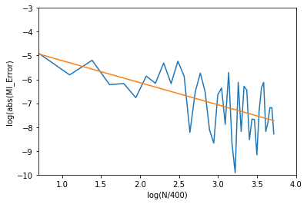
Variation in N (2)
The slope of the best fit line here (R^2=0.73) is actually around -0.8, which isn’t quite what we would expect!
This phenomenon is discussed a bit more in the report.

Slide 11
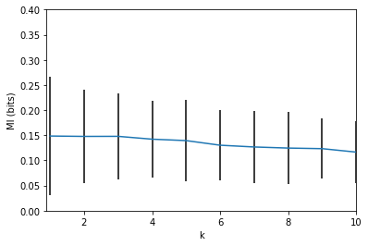
Error bar plot #1: Square Wave (N=400)
Similar to Gaussian case just discussed, the estimator isn’t reliable and shows a trend as k varies.

Slide 12
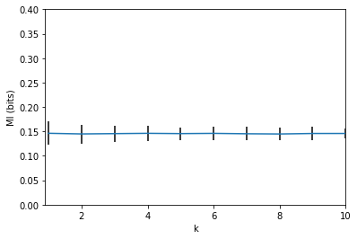
Error bar plot #2: Square Wave (N=10000)
Error bar shows +/- 2sd.
Very strong agreement with the true value 0.145 bits.

Slide 13
Tools and Format
JIDT is written in Java; my scripts are entirely in Python. The library used to interface between the two is Jpype.
There are five scripts, all included as a .zip with the report:
Main calculator (MI)
CMI
Data_Generators (contains functions only)
Integral_Gaussian (for computing true MI in Gaussian case)
Integral_Square (for computing true MI in Square Wave case)

Slide 14
Demonstrations!
Mutual information calculator
Data generation mechanism
CMI script
Enjoy!

Slide 15
References
Lizier, J. (2014). JIDT: an information-theoretic toolkit for studying the dynamics of complex systems.
Ross, B. (2014). Mutual Information between Discrete and Continuous Data Sets.
Kraskov, A. et. al. (2004) Estimating mutual information.
(Report only) Gao et.al. (2017). Estimating Mutual Information for Discrete-Continuous Mixtures.

